Slide 1

CSET 150
Network Design and Management
Evening Masters Edition
Dr. Mahboob Qaosar
Associate Professor, CSE, RU

Slide 2
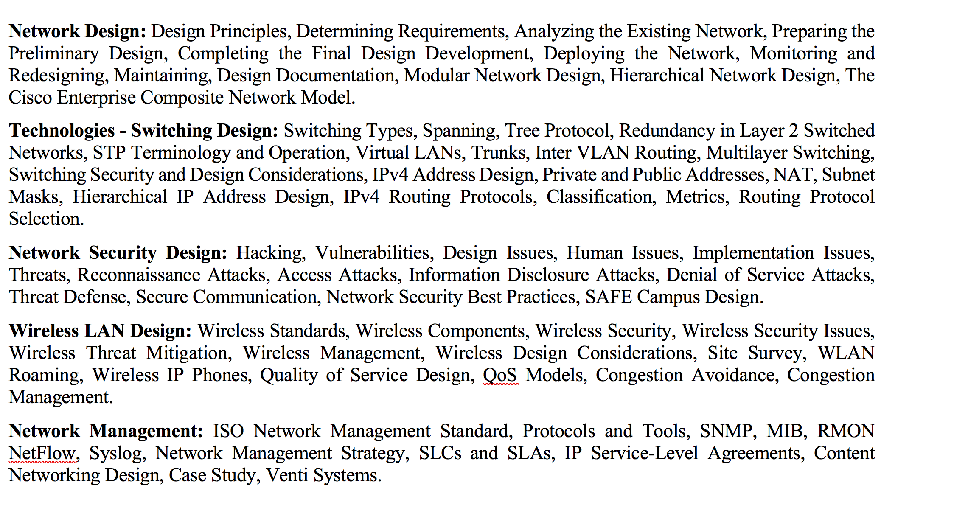
Course Contents

Slide 3
TYPES OF FRAMES
In 802.11 …following types of frames are transferred over the airwaves:
Data frame: Network traffic.
Control frame: Frame controlling access to the medium, similar to a modem's analog connection control mechanism, with its Request To Send (RTS), Clear To Send (CTS), and acknowledgment (ACK) signals.
Manager frame: Frames similar to data frames, pertaining to the control of the current wireless transmission

Slide 4
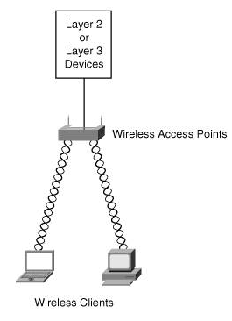
Wireless Components
The main components of wireless networks are as follows:
Wireless access points
Wireless client devices
Wireless Access Points
WAPs provide connectivity between wireless client devices and the wired network.

Slide 5
Wireless Access Points
Integrated Access Point
The WAP does not need to be a stand-alone device.
Cisco offers integrated access point functionality for some small- to medium-business (SMB) routers
By installing a high-speed wireless interface card (HWIC) in Cisco 1800, 2800, or 3800 routers, customers can run concurrent routing, switching, and security services and include IEEE 802.11 wireless LAN functionality in a single platform.

Slide 6
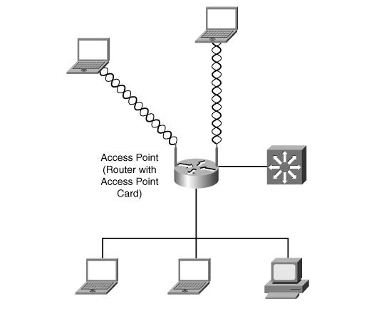
Wireless Access Points

Slide 7
Wireless Client Devices
Hardware:
Wireless access points
Wireless client devices
Wireless Client Devices
A wireless client device is equipped with a wireless interface card (WIC), which the device uses to communicate over RF with WAPs.

Slide 8
Wireless Client Devices
Wireless clients can be the following items:
User workstations and laptops
PDAs (tablets and smart phones)
Wireless IP phones
In addition to connecting to a WLAN access point, two wireless end stations can form an exclusive, point-to-point, wireless network without the intervention of an access point.
This type of independent network is known as an ad-hoc network.

Slide 9
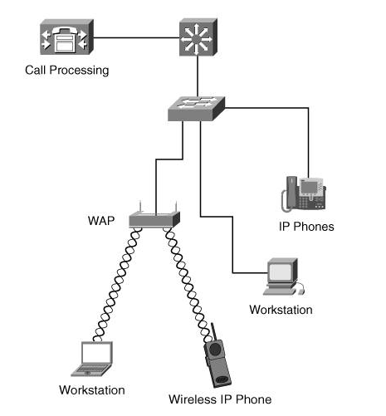
Deploying Wireless IP Phones

Slide 10
Wireless Security
Wireless Security Issues
A main issue with wireless communication is unauthorized access to network traffic or, more precisely, the watching, displaying, and logging of network traffic, also known as sniffing.
Contrary to a wired network, where a hacker would need to be physically located at the corporate premises to gain access through a network drop, with a wireless network, the intruder can access the network from a location outside the corporate building
Wireless equipment tends to ship with open access. Not only is traffic propagated in clear text, but WAPs also voluntarily broadcast their identity, known as Service Set Identifiers (SSIDs)

Slide 11
Wireless Threat Mitigation
Wireless network security can be classified into the following three categories:
Basic wireless security
Enhanced wireless security
Wireless intrusion detection

Slide 12
Basic Wireless Security
Basic Wireless Security
Basic wireless security is provided by the following built-in functions:
SSIDs
Wired Equivalent Privacy (WEP)
Media Access Control (MAC) address verification

Slide 13
SSIDs
Service Set Identifiers ⇨ SSID
An SSID is a code that identifies membership with a WAP.
All wireless devices that want to communicate on a network must have their SSID set to the same value as the WAP SSID to establish connectivity with the WAP.
By default, a WAP broadcasts its SSID every few seconds.
This broadcast can be stopped so that a drive-by hacker can't automatically discover the SSID and hence the WAP.
However, because the SSID is included in the beacon of every wireless frame, it is easy for a hacker equipped with sniffing equipment to discover the value and fraudulently join the network
Beacon Frame
The WAP periodically advertises SSID and other network information using a special 802.11 management frame known as a beacon.

Slide 14
Wired Equivalent Privacy (WEP)
WEP can be used to alleviate the problem of SSID broadcasts by encrypting the traffic between the wireless clients and WAPs.
Joining a wireless network using WEP is referred to as shared-key authentication, where the WAP sends a challenge to the wireless client who must return it encrypted.
If the WAP can decipher the client's response, the WAP has the proof that the client possesses valid keys and therefore has the right to join the wireless network.
WEP comes in two encryption strengths: 64-bit and 128-bit.

Slide 15
MAC Address Verification
To further wireless security, a network administrator could use MAC address filtering, in which the WAP is configured with the MAC addresses of the wireless clients that are to be permitted access.
Unfortunately, this method is also not secure because frames could be sniffed to discover a valid MAC address, which the hacker could then spoof.

Slide 16
Enhanced Wireless Security
Wireless network security can be classified into the following three categories:
Basic wireless security
SSIDs
Wired Equivalent Privacy (WEP)
Media Access Control (MAC) address verification
Enhanced wireless security
Wireless intrusion detection

Slide 17
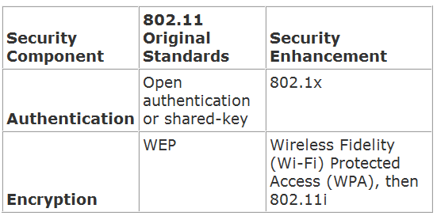
Enhanced Wireless Security

Slide 18
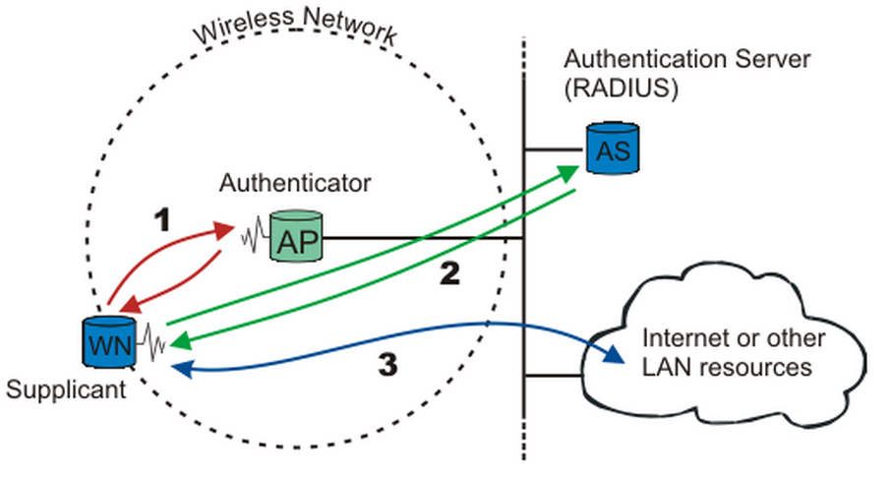
Enhanced Wireless Security
802.1x
IEEE 802.1x is a port-based network access control standard.
It provides per-user, per-session, mutual strong authentication, not only for wireless networks but also for wired networks, if need be.

Slide 19
802.1x
A wireless node must be authenticated before it can gain access to other LAN resources
When a new wireless node (WN) requests access to a LAN resource, the access point (AP) asks for the WN's identity.
No other traffic than EAP is allowed before the WN is authenticated.
Extensible Authentication Protocol, or EAP
After the identity has been sent, the authentication process begins.
The protocol used between the Supplicant and the Authenticator is EAP
The Authenticator re-encapsulates the EAP messages to RADIUS format, and passes them to the Authentication Server.
Remote Authentication Dial In User Service (RADIUS)
After a successful authentication, the Supplicant is granted access to other LAN resources/Internet

Slide 20
Wireless Design Considerations
Some items that should be considered when designing and provisioning a wireless network:
Site Survey
WLAN Roaming
Point-to-Point Bridging

Slide 21
Site Survey
You should ask the following questions:
Which wireless system is best suited for the application?
b/g/n ?
Does a line-of-sight requirement exist between antennas?
Where should the WAP be located so that it is as close as possible to clients?
What potential sources of interference are in this building?
Should any federal, provincial, or local regulations and legislation be considered in this deployment?

Slide 22
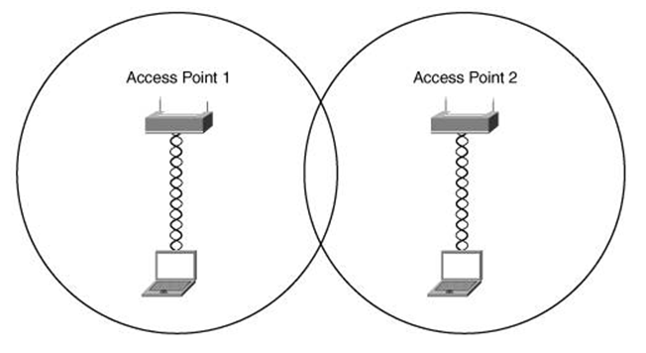
WLAN Roaming
Could be Layer2 or Layer 3.
This problem could be more easily solved with rudimentary planning and by using non-overlapping channels.
Channels 1, 6, and 11 do not overlap

Slide 23
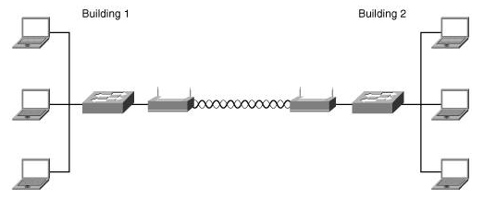
Point-to-Point Bridging
It is not always feasible to run a network cable between two buildings to join their respective LANs.
If the two buildings are a reasonable distance apart and preferably in direct line of sight with each other, wireless bridges can be configured.

Slide 24
Point-to-Point Bridging
It takes two WAPs to create one logical two-port bridge.
In this mode, WAPs are operating in a dedicated point-to-point bridge mode and therefore are no longer operating as wireless access points for clients.

Slide 25
Design Considerations for Wireless IP Phones
a system administrator should conduct another site survey.
Another consideration for wireless IP phones is roaming.
Its need to be Layer2 Roaming
With Layer 2 roaming, devices keep their IP address and therefore the changing to another switch would not be noticeable by users.
Layer 3 roaming would mean that a device would have to change its IP address; this would mean an interruption in the user's connection.
If the connection was to a wireless IP phone, the call would be disconnected; this scenario would likely be unacceptable to users

